Slide 1


SCST1223
Probability & statistical data analysis
CHAPTER 5
Part 3
HYPOTHESIS TESTING
(Two Samples Test)
Innovating Sustainable Solutions

Slide 2
Example Questions on 2 Samples Test
Does taking a small dose of aspirin every day reduce the risk of heart attack?
Compare a group that takes aspirin with one that doesn’t.
Do men and women in the same occupation have different salaries.
Compare a sample of men with a sample of women.
Does fuel A lead to better gas mileage than fuel B?
Compare the gas mileage for a fleet of cars when they use fuel A, to when those same cars use fuel B.

Slide 3

Example
Suppose we have a population of adult men with a mean height of 71 inches and standard deviation of 2.5 inches. We also have a population of adult women with a mean height of 65 inches and standard deviation of 2.3 inches. In this case the researcher is interested in comparing the mean height between men and women. His research question is: Does the mean height of men differ from the mean height of women?. Here, the hypotheses are
where,
m₁= mean height of men
m₂= mean height of women

Slide 4
Inferences from two samples
Two Proportions
Two Means: Independent Samples
Two Dependent Samples (Matched Pairs)
Two Variances or Standard Deviations

Slide 5
Inferences About Two Proportion

Slide 6
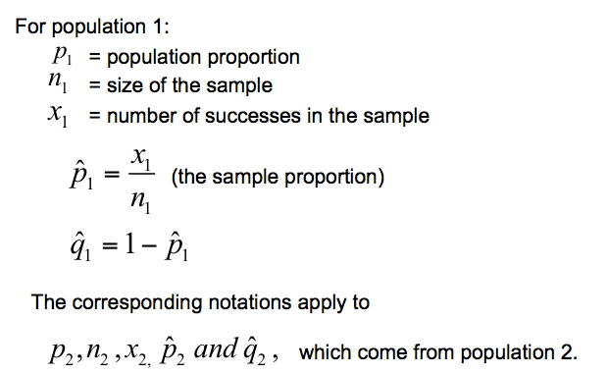
Two Proportions
Notation Symbols:

Slide 7
The pooled sample proportion is given by:

Slide 8
Requirements
1. We have proportions from two independent simple random samples.
2. For each of the two samples, the number of successes is at least 5 and the number of failures is at least 5.

Slide 9
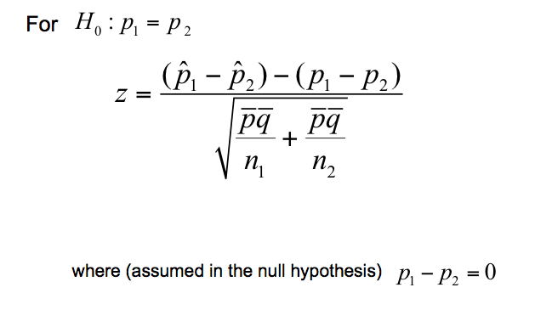
Test Statistic for Two Proportions

Slide 10
Decision Criteria for Two Proportions
P-value: P-values are automatically provided by statistical software (e.g., SPSS). If statistical software is not available, use Table.
Critical values: Use Table A-2.

Slide 11
Example
Do people having different spending habits depending on the type of money they have?
89 undergraduates were randomly assigned to two groups and were given a choice of keeping the money or buying gum or mints.
The claim is that “money in large denominations is less likely to be spent relative to an equivalent amount in many smaller denominations”.
Let’s test the claim at the 0.05 significance level.

Slide 12
Example - Solution
Below are the sample data and summary statistics:
 | Group 1 | Group 2
 | Subjects Given $1 | Subjects Given 4 quarters (1 quarter = 25 cent)
Spent the money | x₁=12 | x₂=27
Subjects in group | n₁=46 | n₂=43

Slide 13
Example
Requirement Check:
The 89 subjects were randomly assigned to two groups, so we consider these independent random samples.
The subjects given the $1 bill include 12 who spent it and 34 who did not. The subjects given the quarters include 27 who spent it and 16 who did not. All counts are above 5, so the requirements are all met.

Slide 14
Example
Step 1:
The claim that “money in large denominations is less likely to be spent” can be expressed as p₁ < p₂.
Step 2: If p₁ < p₂ is false, then p₁ ≥ p₂.
Step 3: The hypotheses can be written as:

Slide 15
Example
Step 4: The significance level is α = 0.05.
Step 5: We will use the normal distribution to run the test with:

Slide 16
Example
Step 6: Calculate the value of the test statistic:

Slide 17
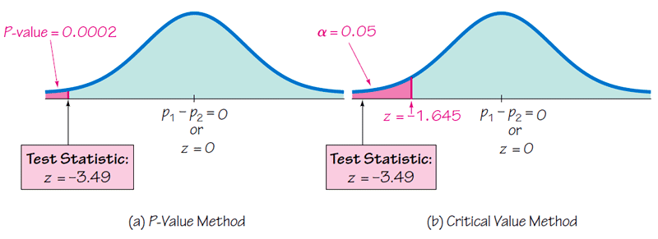
Example
Step 7: This is a left-tailed test, so the P-value is the area to the left of the test statistic z = –3.49, or 0.0001. The critical value is also shown below.
0.0001

Slide 18
Example
Step 8: Because the P-value of 0.0001 is less than the significance level of α = 0.05, thus we reject the null hypothesis.
There is sufficient evidence to support the claim that people with money in large denominations are less likely to spend relative to people with money in smaller denominations.
It should be noted that the subjects were all undergraduates and care should be taken before generalizing the results to the general population.

Slide 19
Exercise #1
Time magazine reported the result of a telephone poll of 800 adult Americans. The question posed of the Americans who were surveyed was: "Should the federal tax on cigarettes be raised to pay for health care reform?" The results of the survey were:
Is there sufficient evidence at the α = 0.05 level, to conclude that the two populations (smokers and non-smokers) is differ significantly with respect to their opinions?
Non-smoker | Smoker
N₁ = 605 | N₂ = 195
Y₁ = 351 said yes | Y₂ = 41 said yes

Slide 20
Inferences About Two Means: Independent Samples

Slide 21
Definition
Two samples are independent if the sample values selected from one population are not related to or somehow paired or matched with the sample values selected from the other population.
Two samples are dependent (or consist of matched pairs) if the members of one sample can be used to determine the members of the other sample.

Slide 22
Example
Independent Samples:
Researchers investigated the reliability of test assessment. On group consisted of 30 students who took proctored tests. A second group consisted of 32 students who took online tests without a proctor.
The two samples are independent, because the subjects were not matched or paired in any way.

Slide 23
Example
Dependent Samples:
Students of the author collected data consisting of the heights (cm) of husbands and the heights (cm) of their wives. Five of those pairs are listed below.
Height of Husband | 175 | 180 | 173 | 176 | 178
Height of Wife | 160 | 165 | 163 | 162 | 166
The data are dependent, because each height of each husband is matched with the height of his wife.

Slide 24
Statistical Inferences For Two Sample:
Test On Difference Between Two MEAN

Slide 25
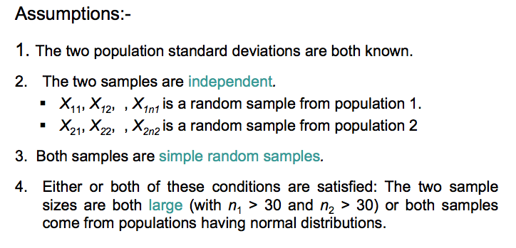
Test on Difference Between Two Mean

Slide 26
Test on Difference Between Two Mean
1
σ₁ and σ₂ (variances) are known
2
σ₁ and σ₂ (variances) are unknown
assume EQUAL VARIANCE
assume UNEQUAL VARIANCE

Slide 27
Test on Difference Between Two Mean (variance are KNOWN)
Two population standard deviation σ₁ and σ₂ are known
The test statistic will be a z and use the standard normal model.

Slide 28
Test on Mean with σ₁ and σ₂ (variances) are known
Consider hypothesis testing on the difference in the means µ₁ ₋ µ₂ of two normal populations.
The procedure of this testing can be summarized as follow:

Slide 29
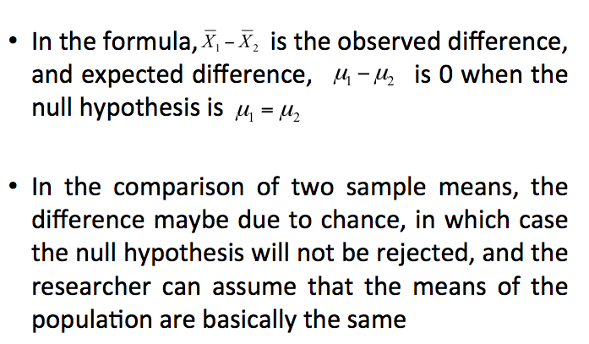
Test on Mean with σ₁ and σ₂ (variances) are known

Slide 30
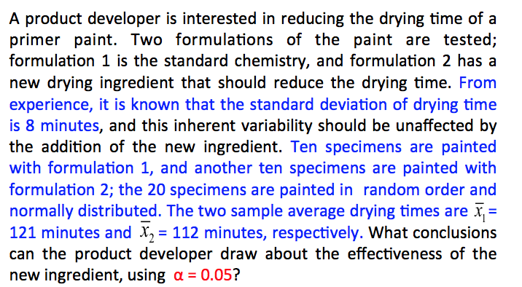
Example

Slide 31
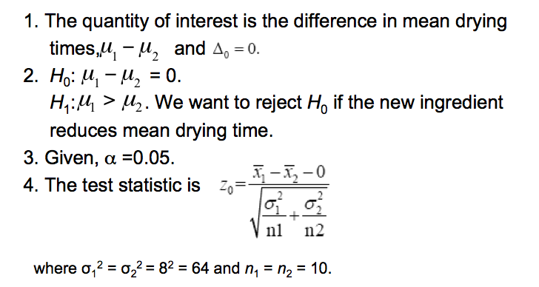
Example - Solution

Slide 32
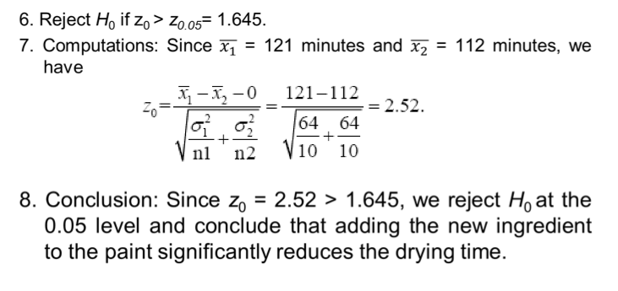

Slide 33
Exercise #2
According to the American Medical Association, the average annual of radiologists in the USA are $230,000 and those of surgeons are $225,000. Suppose that these means are based on random samples of 300 radiologists and 400 surgeons and that the population standard deviations of the annual earnings of radiologists and surgeons are $28,000 and $32,000 respectively. Determine whether there is a difference between the mean annual earnings of radiologists and surgeons with 97% confidence interval.

Slide 34
Test on Mean, Variance unknown
We now consider tests of hypotheses on the difference in means µ₁ - µ₂ of two normal distributions where the variances σ₁² and σ₂² are unknown.
The variances of the two samples may be assumed to be equal or unequal.
σ₁² = σ₂² = σ² (CASE 1 –assumed equal variance)
σ₁² ≠ σ₂² (CASE 2 – assumed unequal variance)
A t-statistic will be used to test these hypotheses.

Slide 35
Case 1 : σ₁² = σ₂² = σ² (assume variance equal)
We wish to test
H₀ : µ₁ - µ₂ =
H₁ : µ₁ - µ₂ ≠
Let X₁₁, X₁₂,...., X_{1n1} be a random sample of n₁ observations from the first population.
Let X₂₁, X₂₂,...., X_{2n2} be a random sample of n₂ observations from the second population.
Let S₁², and S₂² be sample variances, respectively.

Slide 36
Case 1 : σ₁² = σ₂² = σ²
The procedure of testing:

Slide 37
Case 1 : σ₁² = σ₂² = σ²
A pooled estimates of the variance is a weighted average of the variance using the two sample variances and the degree of freedom of each variance as the weights.
The pooled estimator of σ², denoted by S_{p}² is defined by

Slide 38
Example
Two catalysts are being analyzed to determine how they affect the mean yield of a chemical process. Specifically, catalyst 1 is currently in use, but catalyst 2 is acceptable. Since catalyst 2 is cheaper, it should be adopted, providing it does not change the process yield. A test is run in the pilot plant and results in the data shown in Table 1 (next page). Is there any difference between the mean yields? Conduct the t-test with α = 0.05, and assume equal variances.

Slide 39
Table 1

Slide 40

Example - Solution
The parameters of interest are µ₁ and µ₂, the mean process yield using catalysts 1 and 2, respectively, and we want to know if
H₀: = 0.
H₁:
2. Given, α =0.05. The test statistic is

Slide 41
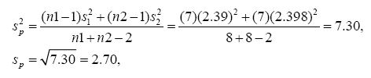
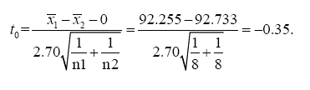
3. Reject H₀ if t₀ > t_{0.025, 14} = 2.145, or
if t₀ < - t_{0.025, 14} = -2.145.
4. Computations: = 92.255 , s₁= 2.39, n₁ =8,
= 92.733, s₂= 2.98, n₂ = 8:
and

Slide 42
Conclusion: Since -2.145 < t₀ = -0.35 < 2.145, fail to reject H₀. That is, at the 0.05 level of significance, we do not have strong evidence to conclude that catalyst 2 results in a mean yield that differs from the mean yield when catalyst 1 is used.

Slide 43
Exercise #3
A sample of 15 children from City A showed that the mean time they spend watching television is 28.5 hours per week with a standard deviation of 4 hours. Another sample of 16 children from City B showed that the mean time they spend watching television is 23.25 hours per week with a standard deviation of 5 hours. Using a 2.5% significance level (95% CI), can you conclude that the mean time spent watching television by children in City A is greater than that for children in City B? Assume that the time spent watching television by children have a normal distribution for both populations and that the standard deviations for the two populations are equal.

Slide 44

Case 2: σ₁² ≠ σ₂² (assume variance unequal)
In some situations, we cannot reasonably assume that the unknown σ₁² and σ₂² are equal.
There is not an exact t-statistic available for testing H₀: µ₁ - µ₂ = in this case.
However, H₀: µ₁ - µ₂ = true, the statistic
is distributed approximately as t.

Slide 45
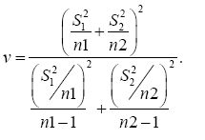
The degrees of freedom given by

Slide 46
Example
Arsenic concentration in public drinking water supplies is a potential health risk. An article in the Arizona Republic (Sunday, May 27, 2001) reported drinking water arsenic concentrations in parts per billion (ppb) for 10 metropolitan Phoenix communities and 10 communities in rural Arizona. The data is given as follows:

Slide 47
We wish to determine it there is any difference in mean arsenic concentrations between metropolitan Phoenix communities and communities in rural Arizona.

Slide 48
Example – Solution
Hypothesis statement:
2. Given, α =0.05. The test statistic is

Slide 49
3. Calculate the degrees of freedom:
Therefore, using α =0.05, we reject H₀
if
or

Slide 50
4. Conclusion:
Since, t₀ = -2.77 < - t_{0.025, 13} = -2.160, we reject the null hypothesis. There is evidence to conclude that mean arsenic concentration in the drinking water in rural Arizona is different from the mean arsenic concentration in metropolitan Phoenix drinking water.

Slide 51
Exercise #4
A sample of 14 cans of Brand I diet soda gave the mean number of calories per can as 23 with a standard deviation of 3 calories. Another sample of 16 cans of Brand II diet soda gave the mean number of calories per can as 25 with a standard deviation of 4 calories. Test at the 1% significance level (99% CI) whether the mean numbers of calories per can of diet soda are different for these two brands. Assume that the calories per can of diet soda are normally distributed for each of these two brands and that the standard deviations for the two populations are not equal.

Slide 52
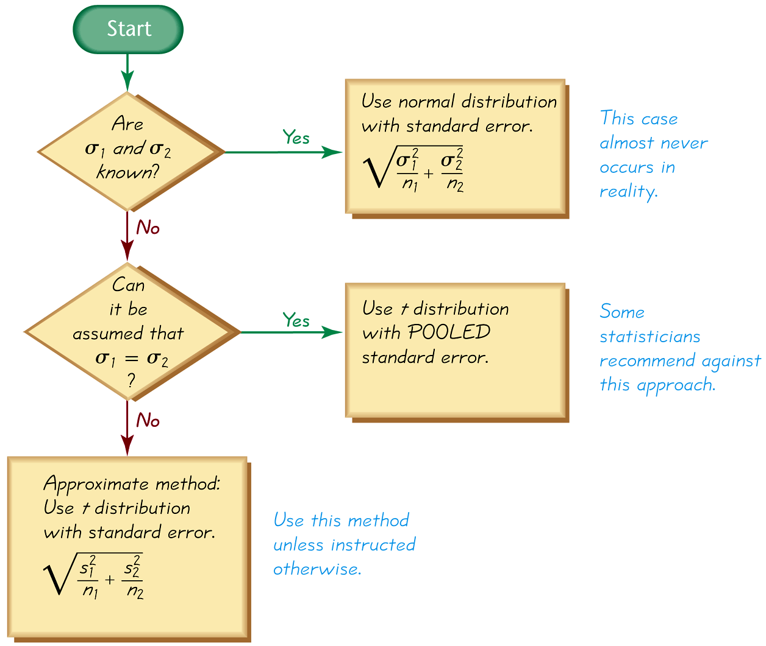
Summary

Slide 53
SCSI2143: Probability & statistical data analysis
CHAPTER 5
Part 3
HYPOTHESIS TESTING
(Two Samples Test)
2016/2017 - Semester 2

Slide 54
Statistical Inferences For Two Sample:
Test On Difference Between
VARIANCE/STANDARD DEVIATION

Slide 55
Test on Difference Between Two Variances
In addition to comparing two means, statisticians are interested in comparing two variances or standard deviation. For example, is the variation in the temperature for a certain month for two cities different?
For the comparison of two variances or standard deviations, an F test is used.

Slide 56
When can this test be used?
There are two samples from two populations
These samples can be different size.
The two samples are independent
Both population are normally distributed
Both population variances and are unknown
We wish to test the hypotheses
H₀: σ₁²= σ₂²
H₁: σ₁² ≠ σ₂²

Slide 57
Let S₁² and S₂² be the sample variances.
The statistic used is the ratio of the two sample variances:
Has an F distribution with degree of freedom
(numerator) and (denominator)
or written as

Slide 59
Example
A researcher wanted to see if women varied more than men in weight. Nine women and fifteen men were weighed. The variance for the women was 525 and the variance for the men was 142. What can be concluded at the 0.05 level of significance?

Slide 60
Example -Solution
Since we are testing to see if the variance for the women is larger than the variance for the men, we let s₁² be the women's sample variance and s₂² the men's sample variance.
The null and alternative hypotheses are

Slide 61
Since
Test statistic:
Degree of freedom
Numerator, n₁-1=9-1=8
Denominator, n₂-1=15-1=14

Slide 62
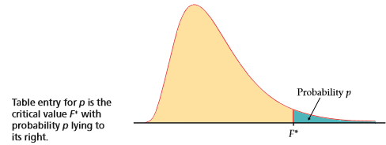
Refer to F-table, α=0.05

Slide 63
Conclusion:
Since we reject the null hypothesis. Hence, we have significant evidence to conclude that the variance for all female weights is larger than the variance for all male weights.

Slide 64
How to find left tail from F-table?
All of the tables only give level of significance for right tail tests.
Because the F distribution is not symmetric, and there are no negative values, you may not simply take the opposite of the right critical value to find the left critical value.

Slide 65
How to find left tail from F-table?
The way to find a left critical value is
to reverse the degrees of freedom
look up the right critical value, and then take the reciprocal of this value.
For example, the critical value with 0.05 on the left with 12 numerator and 15 denominator degrees of freedom is found of taking the reciprocal of the critical value with 0.05 on the right with 15 numerator and 12 denominator degrees of freedom.

Slide 66
How to find left tail from F-table?
Since the left critical values are a pain to calculate, they are often avoided altogether.
You can force the F test into a right tail test by placing the sample with the large variance in the numerator and the smaller variance in the denominator. It does not matter which sample has the larger sample size, only which sample has the larger variance.
If a two-tail test is being conducted, you still have to divide alpha by 2, but you only look up and compare the right critical value.

Slide 67
Exercise #5
A medical researcher wishes to see whether the variance of the heart rates (in beats per minute) of smokers is different from the variance of the heart rates of people who do not smoke. Two samples are selected, and the data are shown. Using α = 0.05, is there enough evidence to support the claim?
Smokers | Non-smokers
n₁=26 | n₂=18
s²=36 | s²=10

Slide 68
Statistical Inferences For Two Dependent Samples
(Matched Pair)

Slide 69
Dependent Sample
Dependent Samples are samples that are paired or matched in some way.
Example:
Samples in which the same subjects are used in a pre-post situation are dependent.
Another type of dependent sample are samples matched on the basis of extraneous to the study.

Slide 70
Determine whether the sample in this case study are paired sample or not.
Example
An engineering association wants to see if there is a difference in the mean annual salary for electrical engineers and chemical engineers. A random sample of electrical engineers is surveyed about their annual income. Another random sample of chemical engineers is surveyed about their annual income.
No, there is no pairing of individuals, you have two independent samples

Slide 71
Determine whether the sample in this case study are paired sample or not.
Example
A pharmaceutical company wants to test its new weight-loss drug. Before giving the drug to volunteers, company researchers weigh each person. After a month of using the drug, each person’s weight is measured again.
Yes, you have two observations on each individual, resulting in paired data.

Slide 72
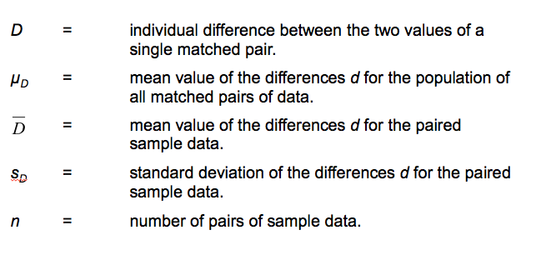
Notation for Dependent Samples

Slide 73
Requirements
1. The sample data are dependent.
2. The samples are simple random samples.
3. Either or both of these conditions is satisfied: The number of pairs of sample data is large (n > 30) or the pairs of values have differences that are from a population having a distribution that is approximately normal.
Notes:
page 485 of Elementary Statistics, 10th Edition

Slide 74
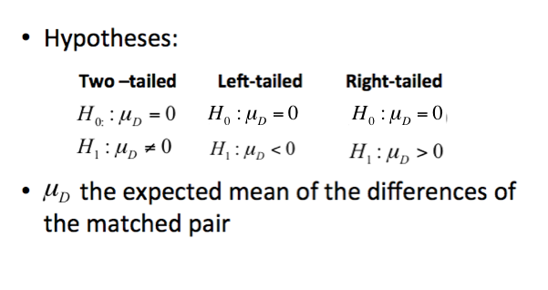
Hypotheses

Slide 75
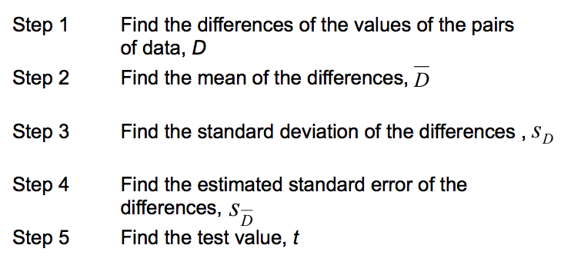
General Procedure – Finding the Test Value

Slide 76
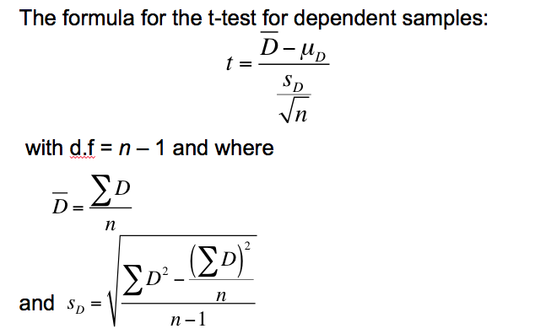
Formula of t –test for Dependent Sample

Slide 77
Example
A physical education director claims by taking a special vitamin a weight lifter can increase his strength. Eight athletes are selected and given a test of strength, using the standard bench press. After two weeks of regular training, supplemented with the vitamin, they are tested again. Test the effectiveness of the vitamin regime at a =0.05. Each value in these data represents the maximum numbers of pounds the athlete can bench-press. Assume that the variables is approximately normally distributed
Athlete | 1 | 2 | 3 | 4 | 5 | 6 | 7 | 8
Before (x₁) | 210 | 230 | 182 | 205 | 262 | 253 | 219 | 216
After (x₂) | 219 | 236 | 179 | 204 | 270 | 250 | 222 | 216

Slide 78
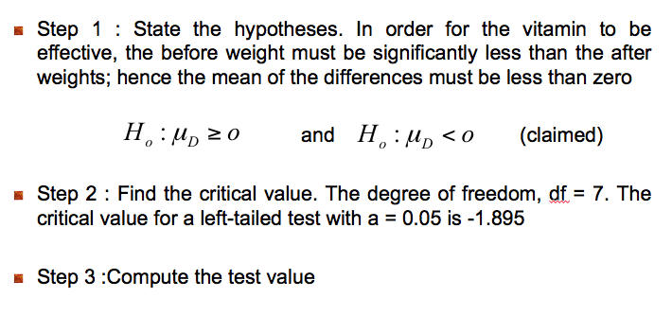
Example - Solution
H₀ : μ_{D} = 0
H₁ : μ_{D} < 0

Slide 79
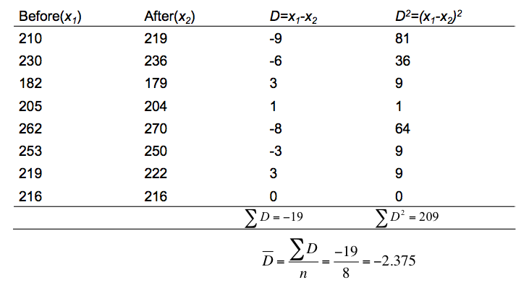

Slide 80
Calculate the standard deviation of the differences:
Calculate the t-test value:

Slide 81
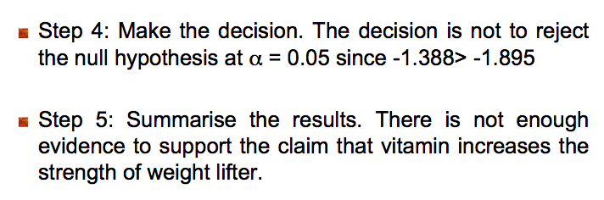

Slide 82
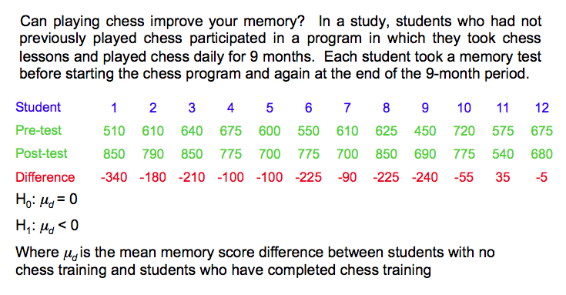
Example
Conduct the hypothesis testing with 0.05 level of significance.

Slide 83
Example – Solution
Hypothesis: H₀: μ_{d} = 0 ; H₁: μ_{d} < 0
Test Statistic:
t - value from table: -1.796
Since -4.56 < -1.796, we reject H₀. There is convincing evidence to suggest that the mean memory score after chess training is higher than the mean memory score before training.

Slide 84
Exercise #6
Table below lists SAT scores before and after the sample of 10 students took a preparatory course. Is there sufficient evidence to conclude that the preparatory course is effective in raising scores? Use a 0.05 significance level.
Student | A | B | C | D | E | F | G | H | I | J
SAT score before course | 700 | 840 | 830 | 860 | 840 | 690 | 830 | 1180 | 930 | 1070
SAT score after course | 720 | 840 | 820 | 900 | 870 | 700 | 800 | 1200 | 950 | 1080

